Slide 1
Meeting Three
DPM Final Project
Fall 2017
Team 6
GANTT and budget review, mechanical design presentation, software architecture overview, and testing status

Slide 2
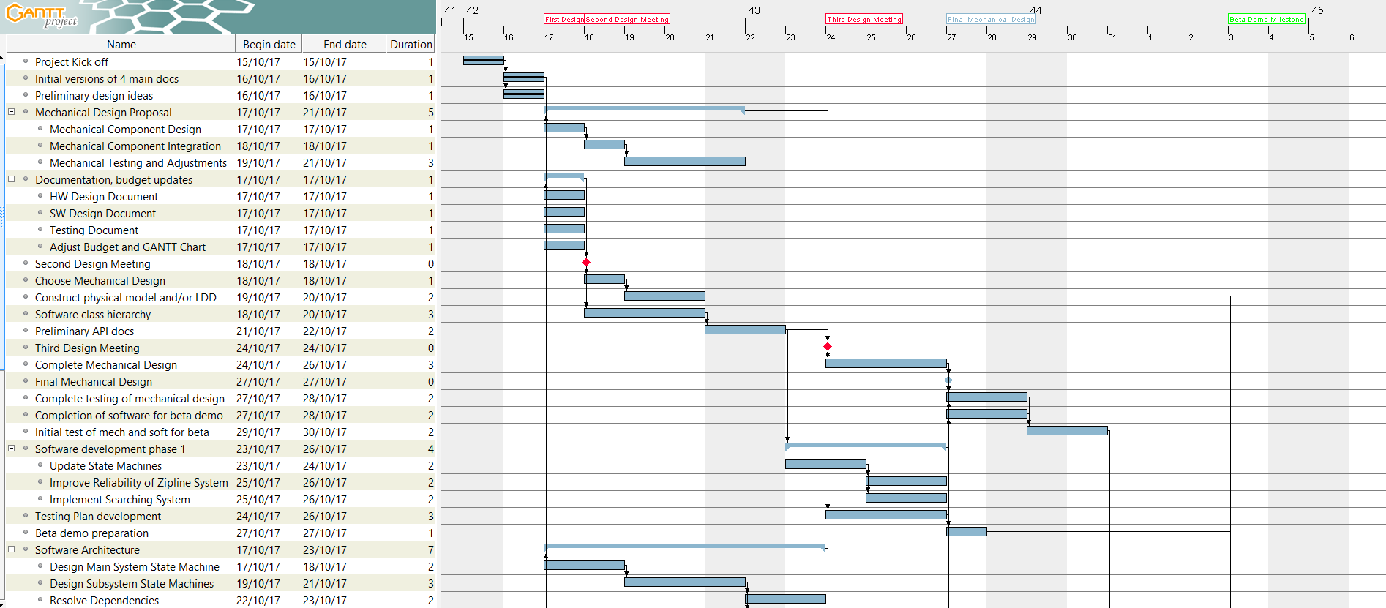
GANTT Chart Update

Slide 3
Budget Update

Slide 4
Mechanical Design Selection
Physical Characteristics
SENSORS: 3x colour sensor 1x ultrasonic sensor
MOTORS: 2x large EV3 motor - navigation 1x large NXT motor – zipline pulley operation 1x medium motor – sensor rotation
MEASUREMENTS: wheelbase: 15.2 cm width: 19.8 cm height: 28.5 cm depth: 21.2 cm
Easily accessible battery
Stable on the ground and on the zip line due to calibrated centre of gravity
PROS | CONS
Both the ultrasonic and light sensors positioned in front are low enough. | No remaining ports for gyro sensor.
The ultrasonic and colour sensors can be moved. | The stability of the pivoting sensors should be revised.
Good accessibility to the battery.
The width of the wheels make the robot stable but can also execute tight turns.

Slide 5
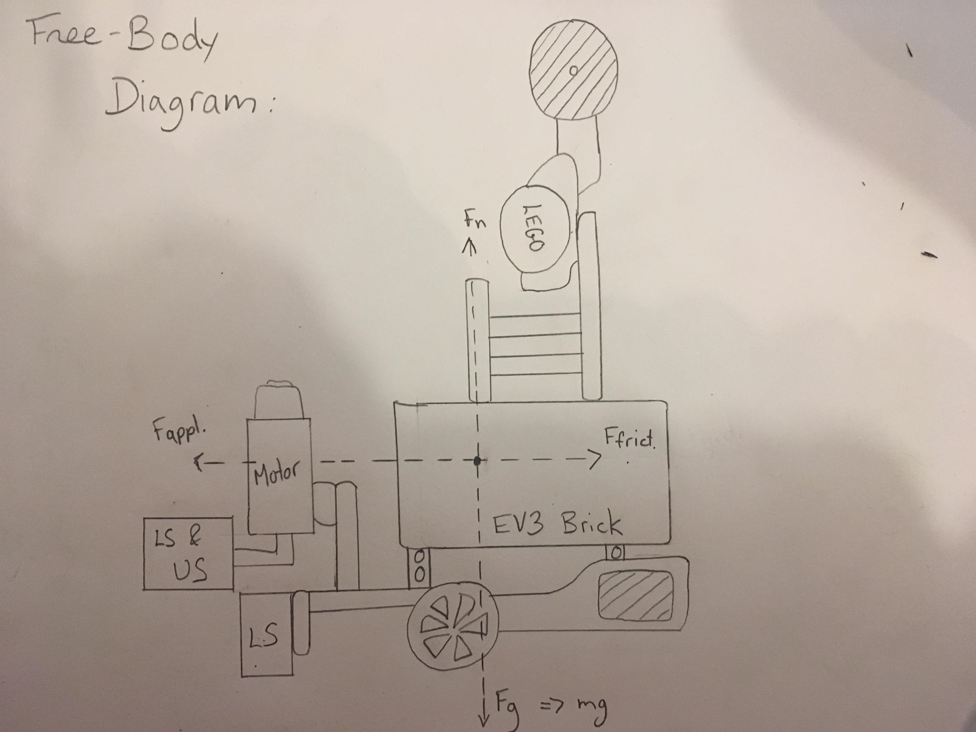

Slide 6
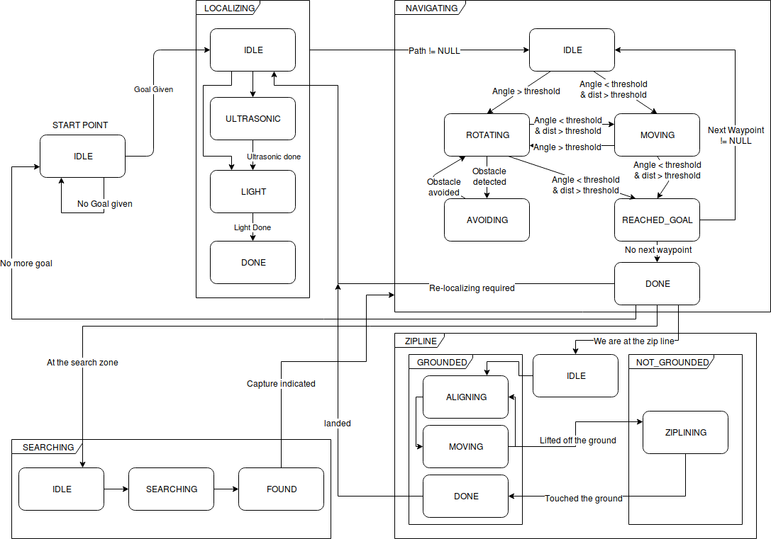
Software Architecture – Updated State Machine

Slide 7
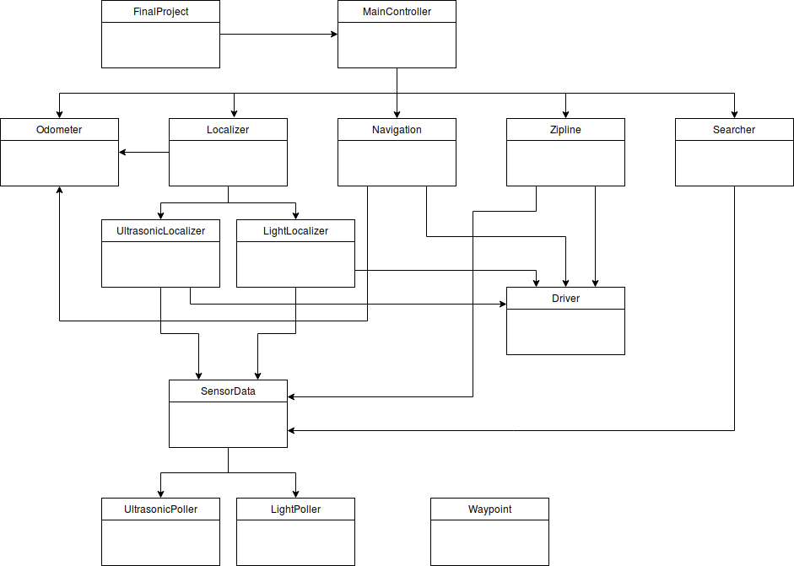
Software Architecture – Updated Class Hierarchy

Slide 8
Testing Status
Testing document has been updated after each test. A copy of the document is uploaded weekly to the Dropbox.
For each test, the following details are noted:
Date
Testers
Hardware and Software Versions
Goal
Procedure
Expected Result
Test Report
Conclusion
Action and Distribution
Tests have been conducted in the following areas:
Stability of robot (driving and ziplining)
Mounting and dismounting of zip line
Accuracy of navigation and localization

Slide 9
Week 3 Plan
Prepare for milestone demonstration
Characterize available sensors and motors to choose those that perform best
Construct the robot that will be used for the demonstration
Complete the first version of the code base
Conduct tests to ensure that the robot will meet the demonstration criteria
Update GANTT chart and budget
Update documentation with the latest details for Monday’s submission

